Slide 1

Economic Challenges 2025-2035 Security and Political Scenarios
Prof. Zvi Eckstein
Head of Aaron Institute for Economic Policy
Reichman University
In collaboration with: Prof. Benjamin Bental, Sani Ziv, Dr. Sarit Menachem-Carmi, Dr. Sergey Sumkin, and Dr. Idit Kalisher
September 2025

Slide 2
Economic Implications of Defense–Political Scenarios
Main scenarios for Gaza:
01
War Ending With an Arrangement
02
War Ending Without an Arrangement
03
Gaza Occupation
Economic analysis: short term (2025–2027) and long term (2028–2035)
Based on estimated defense costs and their effects on growth, deficit, and debt-to-GDP ratio
Focus on: sanctions risk under occupation, fiscal adjustment needs, and growth-enhancing reforms in all scenarios
Occupation of Gaza blocks growth-enhancing reforms, weakens employment and output, and poses risks to financial stability – resembling the “lost decade”
Arrangement, restored security, and reforms will return the economy to a growth trajectory, as after the Second Intifada

Slide 3
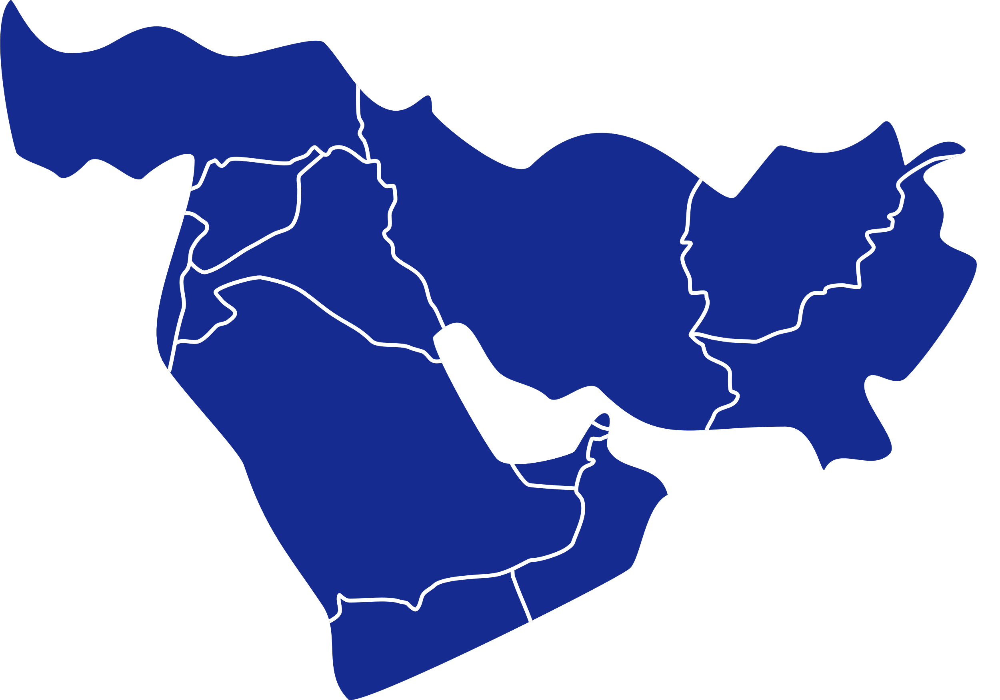
Security Context – Fall 2025
Iran
“Twelve-Day War”: significant damage to Iranian nuclear and missile capabilities
2025–2026: ceasefire
2027–2035: Israeli preparations for additional confrontations
North
Arrangement under current conditions with Lebanon
Return to near-normal economic activity by Q4 2025
Syria: continuation of the existing situation
Gaza
Details ahead
Judea and Samaria
The security situation remains highly tense
Houthis
Occasional missile fire, expected to cease following the end of the Gaza war
The scenario was constructed in consultation with security Experts.

Slide 4
Gaza: Security and Political Scenarios
End of the War in Gaza
No Arrangement | Arrangement by end-2025
Continuation of current hostilities | Military activity declines in late 2025
Israeli responsibility for food distribution | Civil administration by Egypt/international actors (2026)
Economic sanctions, international pressure | Return to political-military status of late 2024
Full Occupation of Gaza
Military and Civilian Control from 2026
Intensive military operations through Q1 2026 Sustained military activity during 2026
Israeli responsibility for food distribution and civilian services, in accordance with international law
Sanctions from European companies and countries Social polarization, emigration from high-tech

Slide 5
Macroeconomic Model for the Short Term, 2025–2027 – Output-Based Framework
01
02
03
Output equals the product of employment and labor productivity
Output =
Employment X Labor productivity
Economic activity is divided to three sectors
High-tech sector
Business sector (excluding high-tech)
Public sector
2025–2027: Focus on employment and labor productivity (output per worker)
Additional assumptions
Tax revenues exhibit unitary elasticity
Civilian government expenditures, defined by the fiscal numerator
Defense expenditures, based on Aaron Institute estimates (to follow)
Employment levels are estimated according to the defense scenario, accounting for reservists and employees temporarily absent from work

Slide 6
Estimated Defense Expenditures by Scenarios¹
 |  | Actual Expenditures |  |  | Aaron Institute Estimate² | Aaron Institute Estimate³
 |  | 2023 | 2024 |  | 2025 | 2026 | 2027 | 2028 | 2029 | 2030 | ... | 2035
Budget |  | 86 | 104 |  | 110 | 110 | 100 | 103 | 104 | 107 | ... | 103
War + Deferred Expenditures |  | 17 | 81 |  | 53 | 20
Total Expenditures With an Arragnement |  | 103 | 185 |  | 163 | 130 | 100 | 103 | 104 | 107 | ... | 103
Total Expenditures without an Arrangement |  |  |  |  | 163 | 140 | 110 | 113 | 114 | 117 | ... | 113
Occupation of Gaza |  |  |  |  | 179 | 180 | 133 | 134 | 135 | 138 | ... | 134
U.S. Aid⁴ |  | 16 | 33 |  | 28 | 13 | 13 | 13 | 10 | 7 | ... | 0
NIS billions, constant 2023 prices.
Based on 2025 defense budget, including approved additions, and Q4 assessments adjusted to the scenarios.
2026 onward are based on the Mind Israel security framework, in consultation with Dr. Sasson Hadad, adjusted to the scenarios.
Until 2028: according to the U.S. agreement; 2029 onward: Aaron Institute estimate, in consultation, under a declining framework.

Slide 7
Economic Forecast for 2025–2027: Gaza: War Ends under Arrangement
 | 2023 (Actual) | 2024 (Actual) | 2025 (Projection) | 2026 (Projection) | 2027 (Projection)
Employment Growth | 3.3% | 1.1% | 1.9% | 1.5% | 1.7%
Productivity Growth | 1.5%- | 0.4%- | 1.0% | 1.8% | 1.6%
Interest Rate (Nominal) | 4.75% | 4.75% | 4.50% | 4.50% | 4.50%
Output Growth* (Real) | 1.7% | 0.7% | 2.2% | 3.7% | 3.6%
Defense Expenditure (% GDP) | 5.5% | 9.5% | 8.2% | 6.3% | 4.7%
Civilian Expenditure (% GDP) | 34.4% | 34.7% | 33.7% | 33.7% | 33.7%
Deficit (% GDP) | 6.9% | 9.4% | 5.3% | 4.2% | 2.5%
Debt-to-GDP Ratio | 61.5% | 67.8% | 69.0% | 69.2% | 68.0%
Output growth accounts for the loss associated with temporarily absent workers. In line with 2025 policy, fiscal adjustments of 2% GDP are assumed for 2026–2027.

Slide 8
Economic Forecast for 2025–2027: Gaza War Ends Without an Arrangement
 | 2023 (Actual) | 2024 (Actual) | 2025 (Projection) | 2026 (Projection) | 2027 (Projection)
Employment Growth | 3.3% | 1.1% | 1.9% | 1.3% | 1.2%
Productivity Growth | 1.5%- | 0.4%- | 0.2% | 0.2% | 0.2%
Interest Rate (Nominal) | 4.75% | 4.75% | 4.50% | 4.50% | 4.50%
Output Growth* (Real) | 1.7% | 0.7% | 1.3% | 1.7% | 1.9%
Defense Expenditure (% GDP) | 5.5% | 9.5% | 8.3% | 7.0% | 5.4%
Civilian Expenditure (% GDP) | 34.4% | 34.7% | 33.7% | 33.7% | 33.7%
Deficit (% GDP) | 6.9% | 9.4% | 5.4% | 4.9% | 3.3%
Debt-to-GDP Ratio | 61.5% | 67.8% | 69.7% | 71.8% | 72.4%
Output growth accounts for the loss from workers temporarily absent. In line with 2025 policy, fiscal adjustments of 2% GDP are assumed for 2026–2027.

Slide 9
Economic Forecast for 2025–2027: Gaza Occupation and Civilian Administration
 | 2023 (Actual) | 2024 (Actual) | 2025 (Projection) | 2026 (Projection) | 2027 (Projection)
Employment Growth | 3.3% | 1.1% | 1.7% | 1.3% | 1.0%
Productivity Growth | 1.5%- | 0.4%- | 0.1%- | 0.4%- | 0.4%-
Interest Rate (Nominal) | 4.75% | 4.75% | 4.50% | 4.80% | 4.80%
Output Growth* (Real) | 1.7% | 0.7% | 0.7% | 1.1% | 0.9%
Defense Expenditure (% GDP) | 5.5% | 9.5% | 8.5% | 8.8% | 6.6%
Civilian Expenditure (% GDP) | 34.4% | 34.7% | 33.7% | 33.7% | 33.7%
Deficit (% GDP) | 6.9% | 9.4% | 5.6% | 6.9% | 4.9%
Debt-to-GDP Ratio | 61.5% | 67.8% | 70.3% | 74.9% | 77.6%
Output growth accounts for the loss from workers temporarily absent. In line with 2025 policy, fiscal adjustments of 2% GDP are assumed for 2026–2027.

Slide 10
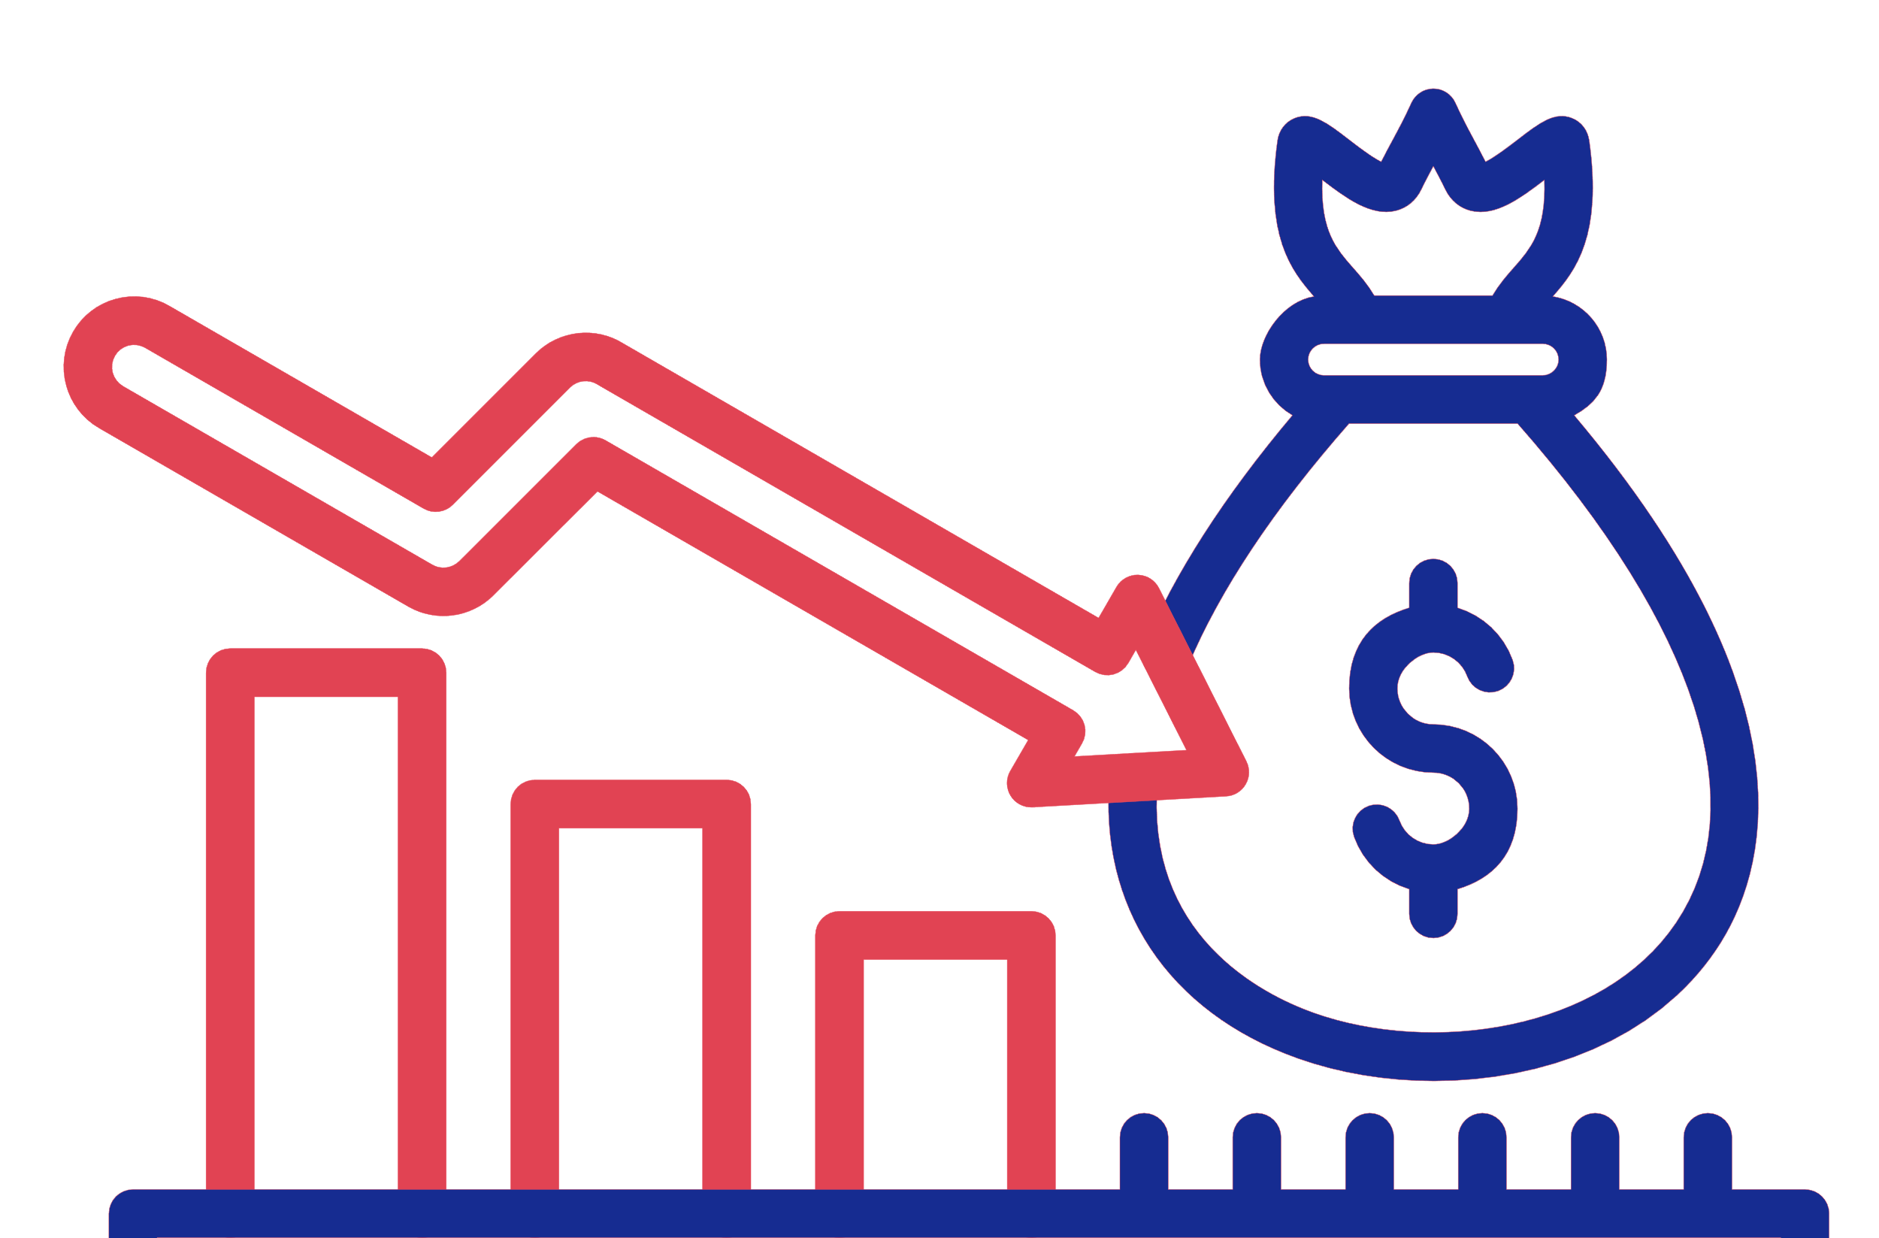




Economic Risks for Israel from 2026 Onward
Failing to meet defense budget needs and reduction in civilian services
Driven by large deficits, high interest rates, and low growth
Risk of a “lost decade”
Diplomatic isolation
Security instability
Multiple conflict arenas
Financial Instability
Diverging Debt-to-GDP ratio
Decline in credit rating
Social Polarization
Intensifying tension between the executive and the judicial authorities
Growing disputes between the political and professional levels
Intensifying conflict over the military service law
Risk of economic sanctions
Decline in trade
Negative impact on employment and output
Negative impact on the high-tech sector
Slowdown in foreign investment and boycotts
Rising risk of emigration of young people with high-quality human capital (brain drain)

Slide 11
Growth Estimates for 2028–2035
Under 2026 Security and Policy Scenarios
Arrangement, Growth-Enhancing Reforms – Annual Growth: 3.7%
Investment in human capital, employment, infrastructure, and digitalization High-tech sector share in output and employment remains high
Arrangement, no Growth-enhancing Reforms – Annual Growth: 2.5%
High-tech’s share in output increases, while its share in employment remains stable
No arrangement, no Growth-Supporting Reforms – Annual Growth: 2.5%
High-tech’s share in output and in employment declines Partial economic sanctions
Occupation of Gaza without Reforms – Annual Growth: 1.0%
High-tech’s share in output and in employment declines sharply Severe economic sanctions – growth reduced by 1.5 percentage points

Slide 12





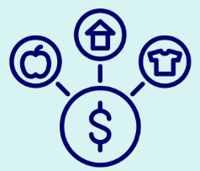
Arrangement with Growth-Enhancing Reforms
  Raising employment rates in Arab and ultra-Orthodox populations
  Investment in transportation infrastructure
  Improving accessibility
Annual Growth: 3.7%
  Closing education gaps
  In Arab and ultra-Orthodox populations
  Sustaining the high-tech sector
  fostering industrial integration and expansion
  Digitalization of the public sector
  Reducing the cost of living
  Promoting competition
Scenario details

Slide 13




Arrangement, no Growth-Enhancing Reforms
  No increase in employment rates among ultra-Orthodox and Arabs
  Limited infrastructure investment in transportation
Annual Growth: 2.5%
  Education distribution remains unchanged
  Gaps persist
  High-tech expands only moderately
  Stable share in employment
Scenario details

Slide 14



No arrangement, no Growth-Enhancing Reforms, High-tech Sector in Decline, Limited International sanctions
  Decline in high-tech employment share
  Due to brain drain and reduced R&D attractiveness
  High-tech sector contraction: share of output declines by 2.8 pp to 17.0%, employment share by 1.4 pp to 8.5%
Annual Growth: 2.0%
  Outflow of skilled human capital (brain drain)
  Driven by economic and security uncertainty
  Annual outflow of 6,000 employees
Decline in foreign and multinational investment
Scenario details

Slide 15

Occupation of Gaza and Civilian Administration, No Growth-Enhancing, High-tech Sector in Decline, International Sanctions
  Sharp fall in exports
  Primarily high-tech, from sanctions
  Disruption of input imports
  Reduces output
  Export share of GDP falls from 35% to 32% by 2037, driven mainly by high-tech services
Annual Growth: 1.0%
  Employment down by 94K compared to 2024
  High-tech share drops 4.4 pp to 15.5% of output and 2.2 pp to 7.7% of employment
  Falling high-tech employment and output
  Accompanied by emigration abroad
Decline in foreign and multinational investment
Scenario details

Slide 16
Absent Growth-Enhancing Reforms –
Debt-to-GDP Ratio Diverges
Forecast to 2035, based on economic-security scenarios
Scenario | Deficit | Interest Rate–Growth Gap | Convergence/ Divergence
Arrangement and growth-enhancing reforms | Low, declining | Negative | Stabilization
Arrangement without growth-enhancing reforms | Low, declining | Near zero | Slow divergence
No arrangement, no growth-enhancing reforms | High and widening | High and widening | Rapid divergence
Gaza Occupation and continuous civilian governance | High and prolonged | High over time | Very rapid divergence
Source: Aaron Institute
Absent growth-enhancing reforms, a full Gaza Occupation threatens fiscal sustainability and obstructs defense funding

Slide 17
Debt-to-GDP Trajectory, 2027–2035
Based on economic-security scenarios
Full Gaza Occupation with civilian administration
Full Gaza Occupation without civilian administration
No arrangement
Arrangement without reforms
Arrangement with reforms
Source: Aaron Institute.

Slide 18
Gaza Occupation: Risk of Financial Crisis
Pre-War
Rapid sustained real growth of ~4% annually
Real interest rate held at ~2% annually
Government maintained responsible fiscal policy with a primary deficit of 1–1.5% of GDP
Result: Debt-to-GDP ratio declined from 90% at the early 2000s to 60% at the eve of the war
2027-2023
Debt-to-GDP trajectory reverses
Growth slows below the real interest rate
Significant rise in the primary deficit
Debt-to-GDP rises to 79% by 2027
Outcome – Risk of Financial Crisis
Diverging debt-to-GDP trajectory
Financial markets aware of rising risks
Possible raising in interest further widen the growth-interest gap
Risk of state unable to raise funds
Loss of public confidence, deposit withdrawals
Heightened risk of capital market collapse

Slide 19
Arrangement: Economic stability achievable through fiscal adjustment and growth-oriented reforms
2017-2022
Rapid sustained real growth of ~4% annually
Government maintained responsible fiscal policy
Result: Debt-to-GDP ratio declined from 90% in the early 2000s to 60% on the eve of the war
2027-2035
Stabilization of the debt-to-GDP ratio by 2027
Return to annual growth rates of 3.5%–4%
Result: The economy returns to stability and sustainable growth
Enables financing of the increase in defense expenditures of about 1% of GDP
Implementation and financing of growth-enhancing reforms and reduction of the cost of living
Requires only moderate fiscal adjustment

Slide 20
Appendix

Slide 21







Employment Estimates – Including Reservists and Temporarily Absent Workers* (thousands)
 |  | Actual data |  |  | Projection
 |  | Q4 23 | Q4 24 | Q1 25 | Q2 25 | Q3 25 | Q4 25 | 2026 | 2027
War Ending With an Arrangement | Reserve duty | 220 | 90 | 70 | 100 | 80 | 70 | 50 | 50
 | Temporarily absent from work ** | 310 | 40 | 30 | 50 | 40 | 30 | 30 | 10
War Ending Without an Arrangement | Reserve duty | 220 | 90 | 70 | 100 | 80 | 50 | 40 | 30
 | Temporarily absent from work ** | 310 | 40 | 30 | 50 | 40 | 20 | 20 | 10
Gaza Occupation | Reserve duty | 220 | 90 | 70 | 100 | 80 | 100 | 100 | 100
 | Temporarily absent from work ** | 310 | 40 | 30 | 50 | 50 | 50 | 30 | 30
Based on CBS Labor Force Survey data and estimates of the population exposed to fire in the North.
** Excluding workers temporarily absent from work due to reserve duty.
The macroeconomic forecast was constructed using the data in the table, according to sectoral distribution and sector-specific productivity.

Slide 22
Breakdown of the Defense Budget*
War Ending Without an Arrangement
Gaza Occupation
 |  | 2025 | 2026 | 2027
 |  | 110 | 110 | 100
Deferred Expenditures | Iron Swords | 25 | 6
 | Gideon's Chariots+ Rising Lion | 28 | 14
Routine Security |  |  | 5-15 | 5-15
Total Budget |  | 163 | 135-145 | 104-114
 | 2025 | 2026 | 2027
Budget + Deferred | 163 | 130 | 100
Gaza Occupation | 3 | 13
Routine Security** |  | 5-15 | 5-15
Military Administration*** |  | 9-19 | 9-19
Civil Administration + Food Supply |  | 7 | 7
Total Addition to Gaza Occupation | 3 | 44 | 31
Budget inc. Civil Administration | 166 | 174 | 131
* In NIS billions, constant 2023 prices
** For Gaza Occupation: routine security and military administration total in 24 billion NIS in 2025.
Source: Aaron Institute, iin consultation with Dr. Sasson Haddad. 2027 – based on Mind Israel strategy and Aaron Institute assessments.

Slide 23
Economic Assumptions for 2025–2027:
War Ending with an Arrangement
Assumptions on employment growth, labor productivity, output, and overall GDP, 2025–2027
 | Employment |  |  | GDP per Worker |  |  | GDP
2027-2025 | 2025 | 2026 | 2027 | 2025 | 2026 | 2027 | 2025 | 2026 | 2027
High-Tech Sector | 1.5% | 2.5% | 3.5% | 6.0% | 6.0% | 4.0% | 7.5% | 8.5% | 7.5%
Non-High-Tech Sector | 0.5% | 0.7% | 1.0% | 0.5% | 1.0% | 1.0% | 1.0% | 1.7% | 2.0%
Business Sector | 0.7% | 1.0% | 1.5% | 2.0% | 2.7% | 2.3% | 2.8% | 3.7% | 3.8%
Public Sector | 3.5% | 2.0% | 2.0% | 0.0% | 0.0% | 0.0% | 3.5% | 2.0% | 2.0%
Total* (result)* | 1.9% | 1.5% | 1.7% | 1.0% | 1.8% | 1.6% | 3.0% | 3.3% | 3.3%
Source: Aaron Institute
Employment: Based on past trends. For the high-tech sector, employment growth is assumed to be half of the rate in 2017–2022.
Output per worker: Based on past trends. For high-tech, GDP per worker growth assumed at the 2017–2022 rate.
* The gap between output growth and employment growth reflects expected productivity gains (measured as GDP per hour worked).

Slide 24
Past Trends in Growth: Employment, Productivity, and GDP
2012–2024
 | Employment |  |  |  | Productivity |  |  |  | GDP
Period | 2012- 2017 | 2017- 2022 | 2023 | 2024 | 2012- 2017 | 2017- 2022 | 2023 | 2024 | 2012- 2017 | 2017- 2022 | 2023 | 2024
High-tech sector* | 5.0% | 7.4% | 3.1% | -2.5% | -2.6% | 4.5% | 10.0% | 5.2% | 2.4% | 12.3% | 13.4% | 2.6%
Non-high-tech sector | 2.3% | 0.3% | 3.0% | 0.0% | 2.1% | 2.7% | -5.9% | -1.9% | 4.5% | 3.1% | -3.0% | -1.9%
Business sector | 2.7% | 1.4% | 3.0% | -0.4% | 1.4% | 3.4% | -2.1% | -0.3% | 4.1% | 4.9% | 0.9% | -0.7%
Public sector | 2.6% | 2.4% | 3.6% | 3.1% | 0.3% | -0.4% | 0.8% | 1.9% | 2.9% | 2.1% | 4.4% | 5.1%
Total economy (aggregate) | 2.6% | 1.8% | 3.3% | 1.1% | 1.1% | 2.3% | -1.5% | -0.4% | 3.8% | 4.2% | 1.7% | 0.7%
*High-tech sector:* The 2024 output growth figure is based on data for output growth, export growth, and the distribution of capital inflows during 2020–2024, assuming that the capital stock utilized by the sector remains relatively stable over these years. Specifically, capital raised in 2020 is spread over three years, capital raised in 2021–2023 is spread over five years, and capital raised in 2024 is spread over four years—based on discussions with experts in the high-tech industry.

Slide 25
Economic Assumptions for 2025–2027:
War Ending without an Arrangement
Assumptions on employment growth, labor productivity, output, and overall GDP, 2025–2027
 | Employment |  |  | GDP per Worker |  |  | GDP
2027-2025 | 2025 | 2026 | 2027 | 2025 | 2026 | 2027 | 2025 | 2026 | 2027
High-Tech Sector | 1.5% | 1.2% | 1.0% | 2.0% | 2.0% | 2.0% | 3.5% | 3.2% | 3.0%
Non-High-Tech Sector | 0.5% | 0.5% | 0.5% | 0.5% | 0.0% | 0.0% | 1.0% | 0.5% | 0.5%
Business Sector | 0.6% | 0.6% | 0.6% | 0.7% | 0.7% | 0.7% | 1.2% | 1.2% | 1.2%
Public Sector | 3.5% | 2.0% | 2.0% | 0.0% | 0.0% | 0.0% | 3.5% | 2.0% | 2.0%
Total* (result)* | 1.9% | 1.3% | 1.2% | 0.2% | 0.2% | 0.2% | 2.1% | 1.5% | 1.4%
Source: Aaron Institute
Employment: Based on past trends. For the high-tech sector, employment growth is assumed to be half of the rate in 2017–2022.
Output per worker: Based on past trends. For high-tech, GDP per worker growth assumed at the 2017–2022 rate.
* The gap between output growth and employment growth reflects expected productivity gains (measured as GDP per hour worked).

Slide 26
Economic Assumptions for 2025–2027: Gaza Occupation
Assumptions on employment growth, labor productivity, output, and overall GDP, 2025–2027
2027-2025 | Employment |  |  | GDP per Worker |  |  | GDP
High-Tech Sector | 2025 | 2026 | 2027 | 2025 | 2026 | 2027 | 2025 | 2026 | 2027
Non-High-Tech Sector | 1.2% | -1.0% | -1.0% | 2.0% | 0.0% | 0.0% | 3.0% | -1.0% | -1.0%
Business Sector | 0.2% | 1.0% | 1.0% | 0.0% | 0.0% | 0.0% | 0.2% | 1.0% | 1.0%
Public Sector | 0.4% | 0.7% | 0.7% | 0.7% | -0.2% | -0.2% | 1.0% | 0.5% | 0.5%
Total* (result) | 3.5% | 2.0% | 2.0% | 0.0% | 0.0% | 0.0% | 3.5% | 2.0% | 2.0%
2027-2025 | 1.7% | 1.3% | 1.3% | 0.2% | 0.2% | 0.2% | 1.6% | 0.8% | 0.8%
Source: Aaron Institute
Employment: Based on past trends. For the high-tech sector, employment growth is assumed to be half of the rate in 2017–2022.
Output per worker: Based on past trends. For high-tech, GDP per worker growth assumed at the 2017–2022 rate.
* The gap between output growth and employment growth reflects expected productivity gains (measured as GDP per hour worked).

Slide 27
Aaron Institute’s Macroeconomic Model for 2028–2035
Economic Sectors |  | Population groups
High-tech Business (exc. High-tech) Public |  | Non-orthodox Jewish Orthodox Jewish Arabs
Sectoral output is determined by physical capital, public infrastructure (mainly transportation), employment by population group and education, and sector-specific productivity
Employment and Education Targets
Assumptions
Employment: based on education targets
Infrastructure: based on closing transport gaps (Aaron Institute’s framework)
2028 Onward: 4 Defense-Growth Scenarios | War Ending With an Arrangement, Growth-Enhancing Reforms War Ending With an Arrangement, No Growth-Enhancing Reforms War Ending Without an Arrangement, No Growth-Enhancing Reforms Gaza Occupation, No Growth-Enhancing Reforms
Economic Assumptions

Slide 28



Economic Targets for Reform Scenarios
Human Capital Targets for 2035: Arab and Haredi populations
Employment Rate
Raise employment rate of Arab men (25–44) to 85%
Raise employment rate of Arab women (25–44) to 77%
Raise employment rate of Haredi men (25–44) to 66%
Education
Arab men – equalize technological education and reduce academic education gaps by 50% compared to Jewish Non-Haredi men
Women – close education gaps compared to Jewish Non-Haredi women
Closing education gap among Haredi men compared to Non-Haredi men
Wages
Reduce wage gaps among Arabs within each education group (ages 25–44) by 50%
Reduce wage gaps among Haredi men compared to Arabs within each education group (ages 25–44) by 50%

Slide 29
Economic Assumptions for the 2028–2035 Scenarios
Defense Expenditures
  Based on Ministry of Finance data and the Aaron Institute’s defense budget assessments
Civilian Expenditures
  Based on past trends – maintained at a fixed share of 33.7% of GDP
Interest Rate
  Based on the government’s marginal interest rate, required to pay on new debt and partial refinancing of existing debt each year
  Annual linear decline of 0.05 percentage points assumed between 2028–2035

Slide 30


Economic Implications of Sanctions on Israel
Negative link between exposure to economic sanctions and GDP growth rates*
Exports account for ~35% of Israeli GDP
~40% of exports (14% of GDP) are directed to EU countries and others likely to impose sanctions and boycotts
A 10% reduction in exports to these countries is expected to lower GDP by ~1.0%
~25% of production inputs are imported to Israel from EU countries
A 10% reduction in imports of goods is expected to lower GDP by ~0.5%**
Sanctions imposed by the UN are associated with a decline of 2 percentage points in annual growth (over 10 years)
Sanctions imposed by the U.S. are associated with a decline of 0.75–1 percentage point in annual growth
* Neuenkirch, M., & Neumeier, F. (2015). The impact of UN and US economic sanctions on GDP growth. European Journal of Political Economy, 40(PA), 110–125.
** According to input-output tables, the import component in final output is 0.25.

Slide 31
Estimated Overall GDP Loss from Sanctions: 1.5%
(Changes in ratio to baseline scenario, percentage points PPP)
 | Sanctions Impact – Export |  | Sanctions Impact – Imports of Production Inputs |  | Total Impact
 | GDP | Employment | GDP | Employment | GDP | Employment
High-Tech | -2.1% | -2.5% | 0.0% | 0.0% | -2.1% | -3.2%
Business (exc. High-tech) | -0.8% | -0.9% | -1.2% | -1.8% | -2.0% | -3.1%
Public
Total Economy | -0.9% | -0.7% | -0.6% | -0.9% | -1.5% | -1.6%
A 1.5% decline in GDP reflects an annual decrease of about 1.6% in employment, alongside reduced productivity and investment, leading to lower capital accumulation

Slide 32
Employment Forecast to 2035 by Growth Scenarios
Total employment (thousands), Employment rate, and Outflow abroad (thousands)
Growth Scenario | Arrangement and Reforms | Arrangement, No Reforms | No Arrangement, No Reforms
Growth rate | 3.7% | 2.5% | 2.0%
High-tech employment | 627 | 535 | 456
Business sector employment | 3,174 | 3,002 | 3,002
Public sector employment | 1,992 | 1,910 | 1,910
Total employment | 5,794 | 5,447 | 5,368
Employment rate | 63.3% | 59.5% | 59.5%
Migration* (Total 2025-2035) | ---- | ---- | 130
Source: Aaron Institute for Economic Policy.
Notes for migration calculation:
No arrangement, no reforms scenario: based on the expected decline in high-tech employment and slower employment growth in the business sector.
The migration estimate is calculated as the gap between the number of employed persons and the total labor force multiplied by 1.65 (the ratio of emigrants to non-employed adults aged 15+).

Slide 33


Growth-Enhancing Economic Policies 2026 Onwards
Employment Enhancing Policy
Aligned with employment targets set by the 2030 Employment Committee
Growth-Enhancing Structural Reforms
Investments in national infrastructure, regulatory and efficiency reforms, and budget reallocations toward growth-supporting areas
High-Tech Sector
Preserving high-tech as a growth platform for the economy and advancing the transition from a dual economy to an inclusive economy
Projected employment growth:
(annual average)
2.3%
Projected productivity growth:
(annual average)
%4.1
Grows at the pace of overall employment and output –
Stable share in employment and GDP
(pessimistic assumption)
Reduced Macroeconomic Risks
Projected interest rate in 2035: 4.0%
(gradual decrease starting 2026)

Slide 34
2027–2035: Contribution of Policy Reforms to Rapid Growth (%GDP)
Projection for 2035, based on fiscal adjustments and economic policy assumptions
With reforms, projected growth is 3.7% compared to a baseline of 2.5%
Field | Growth Driver | Contribution to Growth (%GDP)
Employment | Increase in Arab population employment | 0.12%
 | Increase in Haredi population employment | 0.07%
Education | Raise education levels in Arab population | 0.13%
 | Raise education levels in Arab population | 0.22%
High-Tech sector | Increase in high-tech share in employment | 0.04%
Infrastructure | Raise transportation public capital | 0.27%
Public sector | Improve productivity through digitalization | 0.07%
Business sector | Increase in private capital | 0.32%
Total |  | 1.2%
Source: Aaron Institute

Slide 35
Growth Estimates 2027-2037 by Industries
Annual Average Rate of Change
Growth Scenario | Arrangement and Reforms | Arrangement, No Reforms | No Arrangement, No Reforms | Gaza Occupation
Total Growth | 3.7% | 2.5% | 2.0% | 1.0%
High-tech | 4.8% | 3.2% | 1.3% | 0.3%
Business sector | 3.4% | 2.2% | 2.2% | 0.7%
Public sector | 3.5% | 2.4% | 2.4% | 2.4%
Source: Aaron Institute

Slide 36
Growth Projections: War Ending With an Arrangement, No Growth-Enhancing Reforms
 | 2037 Estimates | Average Annual Growth Rate | Contribution to Growth
Employment (thousands) | 5,447 | 1.7% | 1.1%
Human Capital Index | 10 | 0.0% | 0.0%
Infrastructure Capital (billion NIS) | 3,862 | 3.2% | 0.3%
Non-Infrastructure Capital | 1,762 | 2.5% | 0.6%
TFP (Total Factor Productivity) | 0.15 | 0.6% | 0.6%
Total GDP (billion NIS, 2020 prices) | 2,283 | 2.5% | 2.5%
GDP per worker (thousand NIS, 2020 prices) | 419 | 0.8% | ----
Source: Aaron Institute

Slide 37
Growth Projections: War Ending With an Arrangement, No Growth-Enhancing Reforms
 | 2037 Estimates | Average Annual Growth Rate | Contribution to Growth
Employment (thousands) | 4,669 | 0.1% | 0.1%
Human Capital Index | 10.0 | 0.0% | 0.0%
Infrastructure Capital (billion NIS) | 3,862 | 3.2% | 0.3%
Non-Infrastructure Capital | 1,658 | 1.9% | 0.5%
TFP (Total Factor Productivity) | 0 | 0.5% | 0.5%
Total GDP (billion NIS, 2020 prices) | 1,972 | 1.0% | 1.0%
GDP per worker (thousand NIS, 2020 prices) | 422 | 0.9%
Source: Aaron Institute

Slide 38
Growth Projections: War Ending Without an Arrangement, No Growth-Enhancing Reforms
 | 2037 Estimates | Average Annual Growth Rate | Contribution to Growth
Employment (thousands) | 5,368 | 1.5% | 1.0%
Human Capital Index | 10 | 0.0% | 0.0%
Infrastructure Capital (billion NIS) | 3,862 | 3.2% | 0.3%
Non-Infrastructure Capital | 1,615 | 1.6% | 0.4%
TFP (Total Factor Productivity) | 0.2 | 0.2% | 0.6%
Total GDP (billion NIS, 2020 prices) | 2,185 | 2.0% | 2.0%
GDP per worker (thousand NIS, 2020 prices) | 407 | 0.5%
Source: Aaron Institute

Slide 39
Growth Projections: Gaza Occupation
 | 2037 Estimates | Average Annual Growth Rate | Contribution to Growth
Employment (thousands) | 4,669 | 0.1% | 0.1%
Human Capital Index | 10.0 | 0.0% | 0.0%
Infrastructure Capital (billion NIS) | 3,862 | 3.2% | 0.3%
Non-Infrastructure Capital | 1,658 | 1.9% | 0.5%
TFP (Total Factor Productivity) | 0 | 0.5% | 0.5%
Total GDP (billion NIS, 2020 prices) | 1,972 | 1.0% | 1.0%
GDP per worker (thousand NIS, 2020 prices) | 422 | 0.9%
Source: Aaron Institute

Slide 40

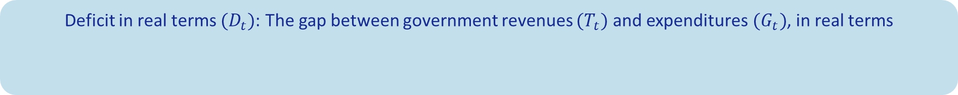
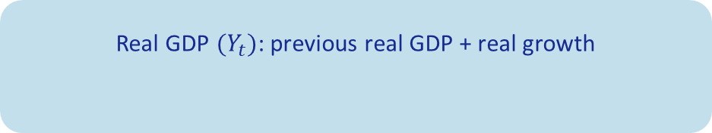
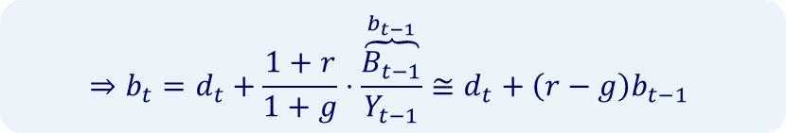
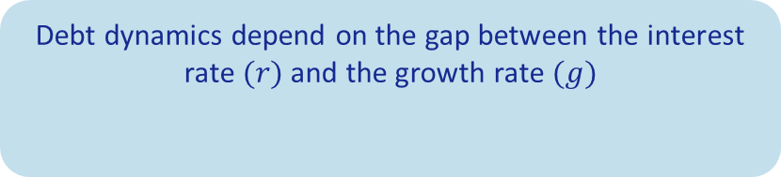

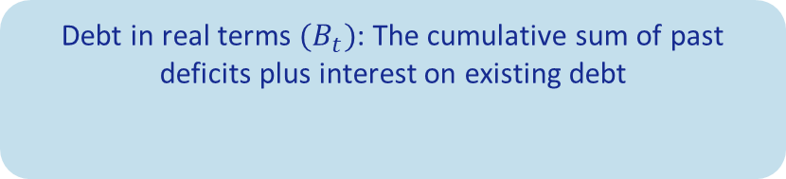
Debt-to-GDP Dynamics
Deficit in real terms $(D_{t})$: The gap between government revenues $(T_{t})$ and expenditures $(G_{t})$, in real terms
$$D_{t}=T_{t}−G_{t}$$
Debt in real terms $(B_{t})$: The cumulative sum of past deficits plus interest on existing debt
Annual increase in debt = deficit + real interest on last year’s debt
$$B_{t}=D_{t}+\left(1+r\right)B_{t−1}$$
$$B_{t}−B_{t−1}=D_{t}+r⋅B_{t−1}$$
Debt-to-GDP ratio $(b_{t})$:
Real GDP $(Y_{t})$: previous real GDP + real growth
$$\frac{B_{t}}{Y_{t}}=\frac{D_{t}}{Y_{t}}+\left(1+r\right)⋅\frac{B_{t−1}}{Y_{t}}$$
$$Y_{t}=\left(1+g\right)Y_{t−1}$$
Debt dynamics depend on the gap between the interest rate $(r)$ and the growth rate $(g)$
The larger the gap between the interest rate and the growth rate, the faster the debt-to-GDP ratio increases
$$⇒b_{t}=d_{t}+\frac{1+r}{1+g}⋅\overset{b_{t−1}}{\overbrace{\frac{B_{t−1}}{Y_{t−1}}}}≅d_{t}+\left(r−g\right)b_{t−1}$$
If the interest rate is higher than the growth rate, debt-to-GDP ratio rises even in the absence of deficit

Slide 41

Growth-Enhancing Reforms | Human Capital and Employment
Raising employment rates among the Arab and the Haredi populations
2035 Targets | 87% | 65% | 77% | 85%
 | Ultra-orthodox Jewish women | Ultra-orthodox Jewish men | Arab women | Arab men
Contribution to Growth
0.19% GDP
Closing education gaps among the Arab and the Haredi Populations
2035 Target: Doubling Arab participation in technological occupations, reducing wages gap by half across all education levels
Contribution to Growth
0.35% GDP

Slide 42



Growth-Enhancing Reforms | Investment in Infrastructure
Investing in transport infrastructure to enhance accessibility, comparable to leading global metropolitan areas
NIS940B
40%
30 kph
2023-2040
~2.1% of annual GDP
Additional 1.3% of GDP allocated to other infrastructure investments
Increase public transport’s share of total travel from 20% to 40% by 2040
Doubling travel speed from 15 to 30 km/h
Contribution to Growth
0.27% GDP

Slide 43


Growth-Enhancing Reforms | Strengthening the High-Tech Sector
Strengthening High-Tech and Digitalization
Strengthening the High-Tech Sector
  Annual growth of 3.5% in high-tech employment
    Partly following the Perlmutter Committee recommendations to expand human capital in high-tech
  Strengthening academia–industry collaborations
  Creating a competitive and predictable business environment
Contribution to Growth
0.3% GDP
Compared to the scenario of no-growth in high-tech
Digitalization
  25% reduction in service providers’ working time through digital transformation and streamlined bureaucracy
Contribution to Growth
0.07% GDP

