Slide 1
ALEX MINTZ
IDC Herzliya
NICHOLAS A. VALENTINO
University of Michigan
CARLY WAYNE
Washington University in St Louis
Behavioral Political Science
Presented at the Israel Political Science Association Annual Meeting,
2021/22

Slide 2
These approaches, which we refer to collectively as BPS, can help explain the many deviations we see in political attitudes, political decision-making, and political behavior that are often predicted from the dominant, alternative approach to understanding politics: Rational Choice.
Behavioral Political Science
A set of ideas from psychology, economics, political science, and communication studies combined in a simple way to greatly enhance our understanding of politics.
What is BPS? One way to define a paradigm is in the negative, listing features that it does not include. Therefore, BPS might simply be considered as any approach that does not adopt classical rational choice assumptions about how individuals make decisions.
BPS is an umbrella framework that consists of various intellectual schools that consider the cognitive constraints and diverse motivations that structure human decision-making in the political realm.

Slide 3
BPS Programs
BPS encapsulates a broad rich set of research programs that test and modify traditional assumptions about the processes and motivations structuring political decision-making, including:
(1) the role, use, influence of heuristics and cognitive biases on decision-making;
(2) the effects of message framing on political attitudes;
(3) institutional factors and the psychology of group decision-making in policy formation;
(4) the role of emotions in political behavior;
(5) individual differences in preferences stemming from personality, values, and norms; and
(6) the importance of motivation and identity in information processing and reasoning.
A common thread connecting all these diverse research programs is that humans regularly fail to live up to at least some of the classical assumptions of RCT.

Slide 4
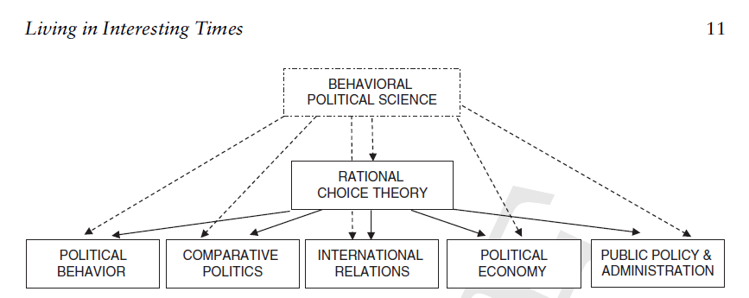
Figure 1.1 BPS is an umbrella framework that consists of various intellectual schools that consider the cognitive constraints and diverse motivations that structure human decision-making in the political realm. It does not replace RCT, but substantially expands our understanding by improving assumptions about human cognitive abilities and motivations in the political realm.

Slide 5
Organizing Themes
We organize the BPS framework along two main dimensions of distinction between the RCT and BPS schools:
First, each approach makes very different assumptions about the abilities political actors possess as they process information and make decisions.
BPS recognizes that humans are suboptimal information processors, whose behavior is influenced by a wide range of factors such as cognitive and information processing limitations, group dynamics, world views, misperceptions, emotions, and framing.
A second major distinction involves motivations. Several approaches in the BPS tradition identify very different motivations for human decision-making compared to those often invoked by RCT. The sources of our varied motivations and goals– have not traditionally received much attention in RCT.

Slide 6
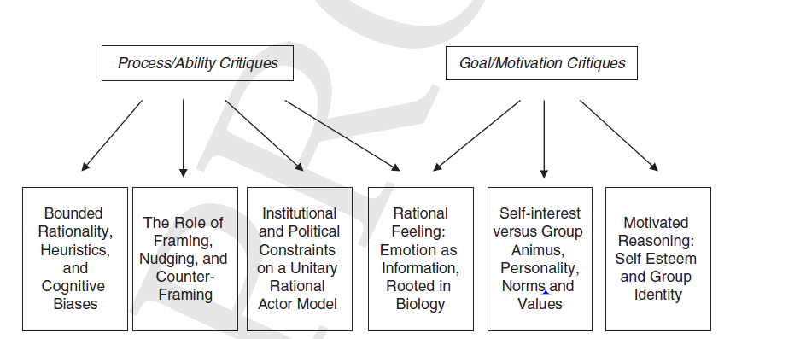
The Book
Figure 1.2 Scheme of the book
The book is organized around two complementary ways in which BPS improves our understanding of politics. The first half of the book focuses on insights about limitations on human cognitive processes and abilities, represented by the first four boxes in the bottom row. The last half takes on new perspectives about the origins of human goals and motivation in the political domain, represented by the last three boxes.

Slide 7
BPS Methods
BPS exhibits a diverse and pluralistic array and scope of methodological orientations.
Research in the BPS tradition consists of four main methodological approaches:
experimental, observational, case study, and, increasingly, formal modeling.
BPS augments RCT both by adding new factors to our understanding of what motivates individual behavior and by demonstrating that people’s ability to process information departs from the maximizing and holistic assessment of information assumed in most RCT models.

Slide 8
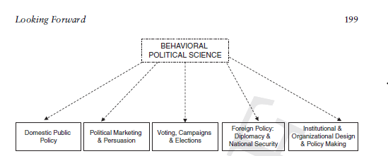
BPS and Public Policy Issue Areas
9.1 BPS and public policy issue areas:
As we have shown throughout the book, BPS is a broad umbrella paradigm that has been applied to a broad set of domains of inquiry within political science, crossing traditional subfields’ boundaries with numerous important policy applications.

Slide 9
Thank You!

